Slide 1

Integrals
RCET 0264 Introductory Calculus
Tim Leishman

Slide 2

Integrals
Integrals:
Also know as Antiderivative.
Purpose is to find the Function of a given differential (or derivative).
Given the known rate of change, $\frac{dy}{dx}$, find the function $y$.
$\int{x^{n}dx}=\frac{x^{n+1}}{n+1}+C$

Slide 3

Integrals
Integrals Example 1: $\int{x^{7}dx}$
$\int{x^{n}dx}=\frac{x^{n+1}}{n+1}+C$
$\int{x^{7}dx} =\frac{x^{7+1}}{7+1}+C$
$\int{x^{7}dx}=\frac{x^{8}}{8}+C$

Slide 4
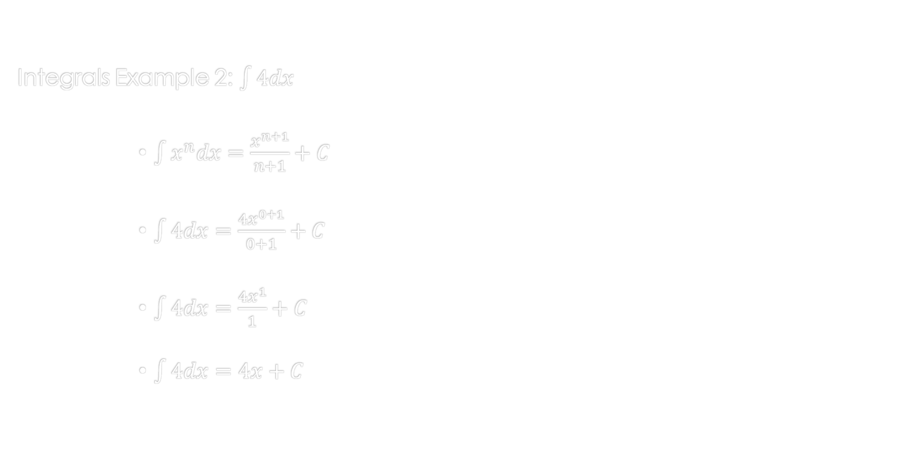
Integrals
Integrals Example 2: $\int{4dx}$
$\int{x^{n}dx}=\frac{x^{n+1}}{n+1}+C$
$\int{4dx}=\frac{4x^{0+1}}{0+1}+C$
$\int{4dx}=\frac{{4x}^{1}}{1}+C$
$\int{4dx}=4x+C$

Slide 5

Integrals
Integrals Example 3: $\int{(5x^{2}−12x+8)dx}$
$\int{x^{n}dx}=\frac{x^{n+1}}{n+1}+C$
$\int{(5x^{2}−12x+8)dx}=\frac{5x^{2+1}}{2+1}−\frac{12x^{1+1}}{1+1}+\frac{8x^{0+1}}{0+1}+C$
$\int{(5x^{2}−12x+8)dx}=\frac{5x^{3}}{3}−\frac{12x^{2}}{2}+\frac{8x^{1}}{1}+C$
$\int{(5x^{2}−12x+8)dx}=\frac{5x^{3}}{3}−6x^{2}+8x+C$

Slide 6
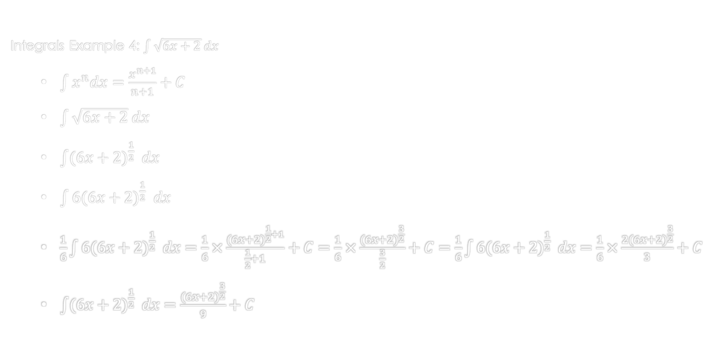
Integrals
Integrals Example 4: $\int{\sqrt{6x+2} dx}$
$\int{x^{n}dx}=\frac{x^{n+1}}{n+1}+C$
$\int{\sqrt{6x+2} dx}$
$\int{{(6x+2)}^{\frac{1}{2}} dx}$
$\int{6{(6x+2)}^{\frac{1}{2}} dx}$
$\frac{1}{6}\int{6{(6x+2)}^{\frac{1}{2}} dx}=\frac{1}{6}×\frac{{(6x+2)}^{\frac{1}{2}+1}}{\frac{1}{2}+1}+C=\frac{1}{6}×\frac{{(6x+2)}^{\frac{3}{2}}}{\frac{3}{2}}+C=\frac{1}{6}\int{6{(6x+2)}^{\frac{1}{2}} dx}=\frac{1}{6}×\frac{2{(6x+2)}^{\frac{3}{2}}}{3}+C$
$\int{{(6x+2)}^{\frac{1}{2}} dx}=\frac{{(6x+2)}^{\frac{3}{2}}}{9}+C$

Slide 7
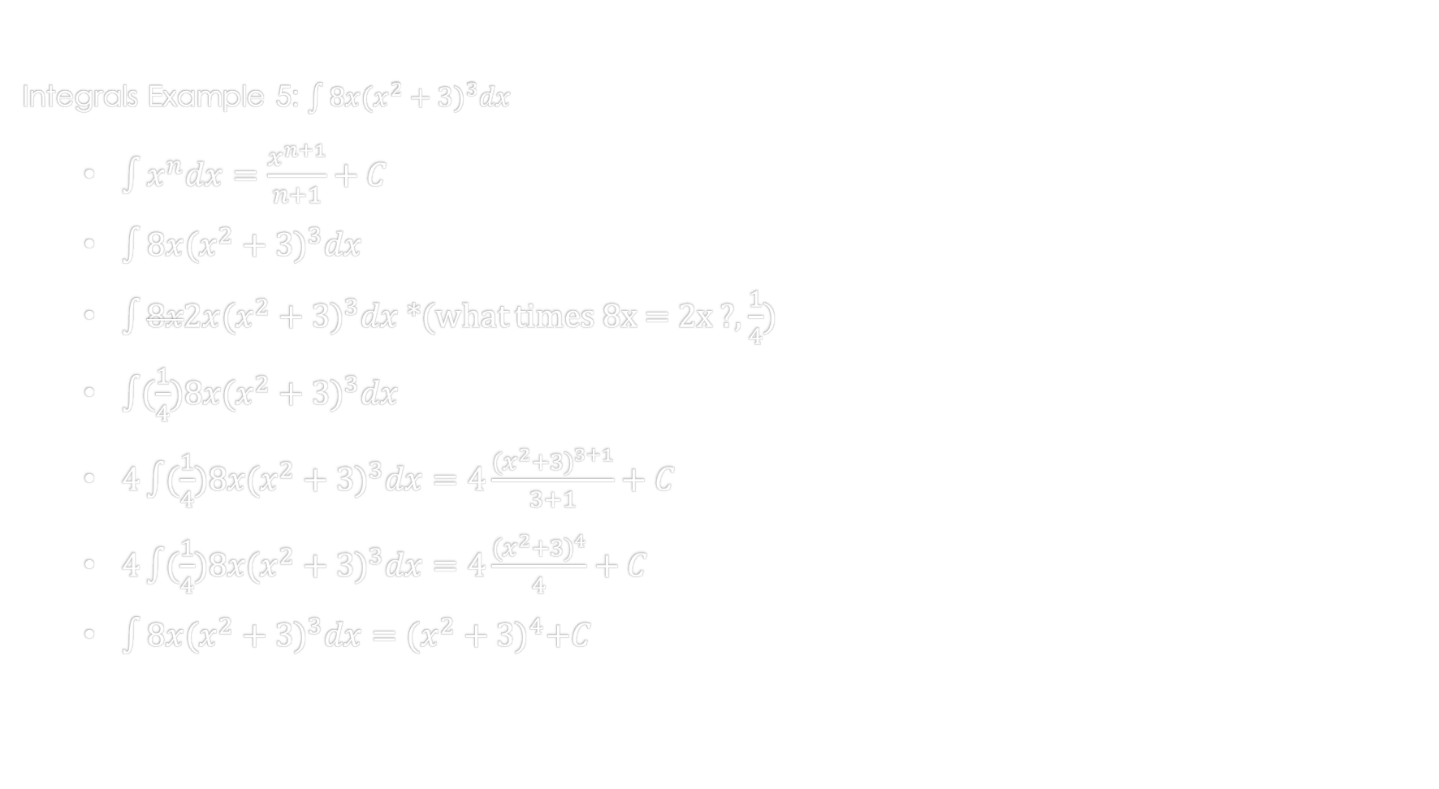
Integrals
Integrals Example 5: $\int{8x{(x^{2}+3)}^{3}dx}$
$\int{x^{n}dx}=\frac{x^{n+1}}{n+1}+C$
$\int{8x{(x^{2}+3)}^{3}dx}$
$\int{8x2x{(x^{2}+3)}^{3}dx}$ *(what times 8x = 2x ?, $\frac{1}{4}$)
$\int{(\frac{1}{4})8x{(x^{2}+3)}^{3}dx}$
$4\int{(\frac{1}{4})8x{(x^{2}+3)}^{3}dx}=4\frac{{(x^{2}+3)}^{3+1}}{3+1}+C$
$4\int{(\frac{1}{4})8x{(x^{2}+3)}^{3}dx}=4\frac{{(x^{2}+3)}^{4}}{4}+C$
$\int{8x{(x^{2}+3)}^{3}dx}={(x^{2}+3)}^{4}+C$

Slide 8
References:
Ewen, D., Gary, J. S., & Trefzger, J. E. (2005). Technical calculus. Upper Saddle River, NJ: Pearson/Prentice Hall.
Richmond, A. E., & Hecht, G. W. (1995). Calculus for electronics. New York: Glence.

